Slide 1
Topic: Understanding Hypervisors

Slide 2
Outline
What is a Hypervisor?
The Role of Hypervisor Technology
Hypervisor vs. Virtual Machine
Hypervisor Types
How Does a Hypervisor Work?

Slide 3
What is Hypervisor?
A hypervisor is software that creates and runs virtual machines (VMs). A hypervisor, sometimes called a virtual machine monitor (VMM), isolates the hypervisor operating system and resources from the virtual machines and enables the creation and management of those VMs.
A hypervisor is a type of software or hardware used to create virtual machines and then run those virtual machines day to day.

Slide 4
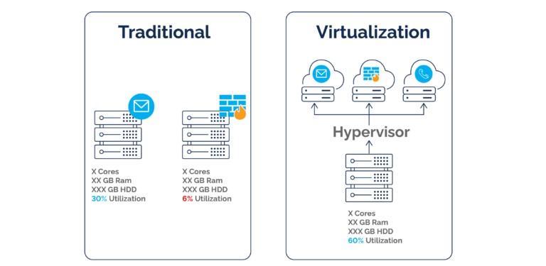
Hypervisor in virtualization

Slide 5
The Role of Hypervisor Technology
The hypervisor is the boss of virtual machines, which we’ll call VMs from here on. The hypervisor allocates resources to VMs or, in other words, manages the physical resources, such as CPU, memory, and storage, that execute functions in the VM environments.
A hypervisor allows one host computer to support multiple guest VMs by virtually sharing its resources, such as memory and processing.

Slide 6
Hypervisor vs. Virtual Machine
It is possible to have VMs without a hypervisor. Such virtualization typically takes the form of containers, basically tinier, cheaper, more portable VMs that use the same O/S as the host machine.
It’s probably best to think of hypervisors and VMs as a package deal, however, with containers representing a different architecture with its own advantages and use cases.

Slide 7
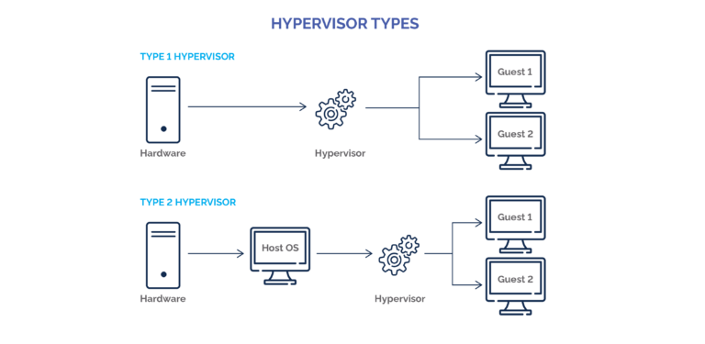
Hypervisor Types

Slide 8
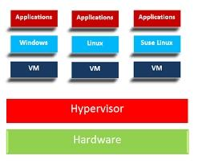
How Does a Hypervisor Work?

Slide 9


